Slide 1

Chapter 3
Feasibility Analysis
Bruce R. Barringer
R. Duane Ireland
Copyright ©2012 Pearson Education, Inc. publishing as Prentice Hall
3-<number>

Slide 2
Chapter Objectives
1 of 3
Explain what a feasibility analysis is and why it’s important.
Discuss the proper time to complete a feasibility analysis when developing an entrepreneurial venture.
Describe the purpose of a product/service feasibility analysis and the two primary issues that a proposed business should consider in this area.
Explain a concept statement and its components.
Describe the purpose of a buying intentions survey and how it’s administered.
Copyright ©2012 Pearson Education, Inc. publishing as Prentice Hall
3-<number>

Slide 3
Chapter Objectives
2 of 3
Explain the importance of library, Internet, and gumshoe research.
Describe the purpose of industry/market feasibility analysis and the two primary issues to consider in this area.
Discuss the characteristics of an attractive industry.
Describe the purpose of organizational feasibility analysis and list the two primary issues to consider in this area.
Copyright ©2012 Pearson Education, Inc. publishing as Prentice Hall
3-<number>

Slide 4
Chapter Objectives
3 of 3
10. Explain the importance of financial feasibility analysis and list the most critical issues to consider in this area.
Copyright ©2012 Pearson Education, Inc. publishing as Prentice Hall
3-<number>

Slide 5
What Is Feasibility Analysis?
Feasibility analysis is the
process of determining whether
a business idea is viable.
It is the preliminary evaluation
of a business idea, conducted
for the purpose of determining
whether the idea is worth
pursuing.
Feasibility Analysis
Copyright ©2012 Pearson Education, Inc. publishing as Prentice Hall
3-<number>

Slide 6
When To Conduct a Feasibility Analysis
Timing of Feasibility Analysis
  The proper time to conduct a feasibility analysis is early in thinking through the prospects for a new business.
  The thought is to screen ideas before a lot of resources are spent on them.
Components of a Properly Conducted Feasibility Analysis
  A properly conducted feasibility analysis includes four separate components, as discussed in the following slides.
Copyright ©2012 Pearson Education, Inc. publishing as Prentice Hall
3-<number>

Slide 7
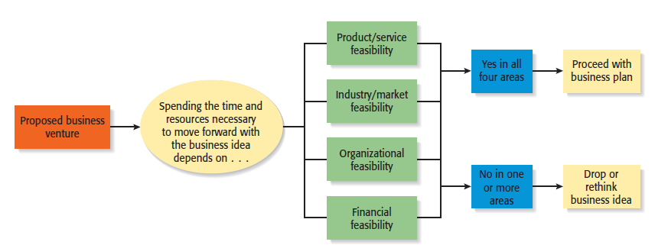
Feasibility Analysis
Role of feasibility analysis in developing business ideas.
Copyright ©2012 Pearson Education, Inc. publishing as Prentice Hall
3-<number>

Slide 8
Forms of Feasibility Analysis
Product/Service Feasibility
Industry/Target Market
Feasibility
Organizational Feasibility
Financial Feasibility
Copyright ©2012 Pearson Education, Inc. publishing as Prentice Hall
3-<number>

Slide 9
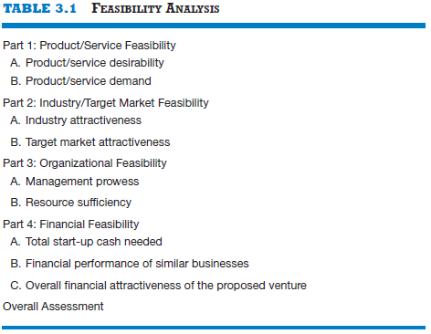
Outline for a Comprehensive Feasibility Analysis
Copyright ©2012 Pearson Education, Inc. publishing as Prentice Hall
3-<number>

Slide 10
Product/Service Feasibility Analysis
1 of 2
Purpose
Is an assessment of the overall
appeal of the product or service
being proposed.
Before a prospective firm rushes
a new product or service into
development, it should be sure
that the product or service is what
prospective customers want.
Product/Service Feasibility Analysis
Copyright ©2012 Pearson Education, Inc. publishing as Prentice Hall
3-<number>

Slide 11
Product/Service Feasibility Analysis
2 of 2
Components of product/service
feasibility analysis
Product/Service
Desirability
Product/Service
Demand
Copyright ©2012 Pearson Education, Inc. publishing as Prentice Hall
3-<number>

Slide 12
Product/Service Desirability
1 of 3
First, ask the following questions to determine the basic appeal of the product or service.
Does it make sense? Is it reasonable? Is it something consumers
will get excited about?
Does it take advantage of an environmental trend, solve a
problem, or take advantage of a gap in the marketplace?
Is this a good time to introduce the product or service to the
market?
Are there any fatal flaws in the product or service’s basic design
or concept?
Copyright ©2012 Pearson Education, Inc. publishing as Prentice Hall
3-<number>

Slide 13
Product/Service Desirability
2 of 3
Second, Administer a Concept Test
  A concept statement should be developed.
  A concept statement is a one-page description of a business that is distributed to people who are asked to provide feedback on the potential of the business idea.
  The feedback will hopefully provide the entrepreneur:
    A sense of the viability of the product or service idea.
    Suggestions for how the idea can be strengthened or “tweaked” before proceeding further.
Copyright ©2012 Pearson Education, Inc. publishing as Prentice Hall
3-<number>

Slide 14
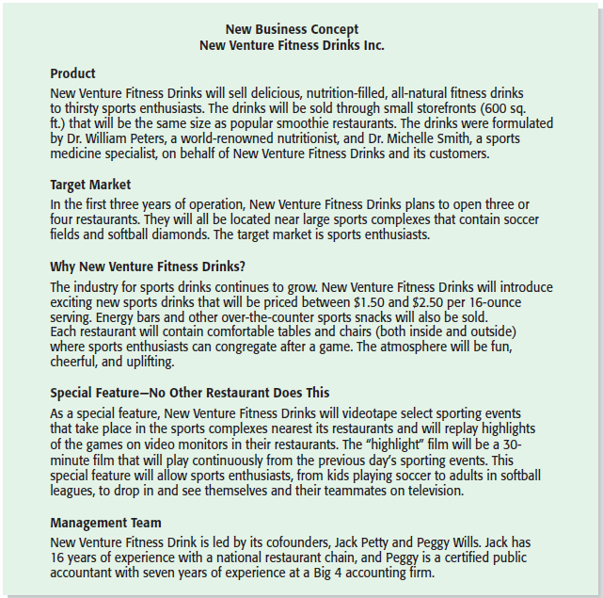
Product/Service Desirability
3 of 3
New Venture Fitness Drink’s Concept Statement
Copyright ©2012 Pearson Education, Inc. publishing as Prentice Hall
3-<number>

Slide 15
Product/Service Demand
1 of 6
Product/Service Demand
  There are two steps to assessing product/service demand.
  Step 1: Administer a Buying Intentions Survey
  Step 2: Conduct Library, Internet, and Gumshoe research
Copyright ©2012 Pearson Education, Inc. publishing as Prentice Hall
3-<number>

Slide 16
Product/Service Demand
2 of 6
Buying Intentions Survey
  Is an instrument that is used to gauge customer interest in a product or service.
  It consists of a concept statement or a similar description of a product or survey with a short survey attached to gauge customer interest.
  Internet sites like SurveyMonkey make administering a buying intentions survey easy and affordable.
Copyright ©2012 Pearson Education, Inc. publishing as Prentice Hall
3-<number>

Slide 17
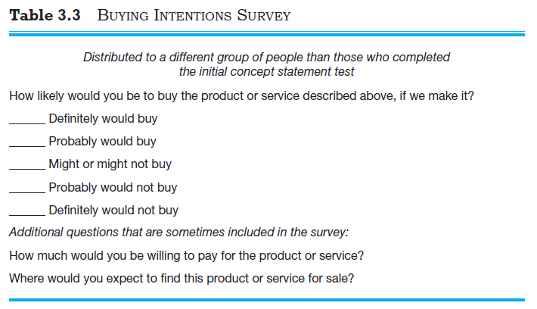
Product/Service Demand
3 of 6
Copyright ©2012 Pearson Education, Inc. publishing as Prentice Hall
3-<number>

Slide 18
Product/Service Demand
4 of 6
Library, Internet, and Gumshoe Research
  The second way to assess the demand for a product or service is by conducting library, Internet, and gumshoe research.
  Reference librarians can often point you toward resources to help you investigate a business idea, such as industry-specific trade journals and industry reports.
  Internet searches can often yield important information about the potential viability of a product or service idea.
Copyright ©2012 Pearson Education, Inc. publishing as Prentice Hall
3-<number>

Slide 19
Product/Service Demand
5 of 6
Explanation
A gumshoe is a detective or an
investigator that scrounges around
for information or clues wherever
they can be found.
Be a gumshoe. Ask people
what they think about your product
or service idea. If your idea is to
sell educational toys, spend a week
volunteering at a day care center
and watch how children interact
with toys.
Gumshoe Research
Copyright ©2012 Pearson Education, Inc. publishing as Prentice Hall
3-<number>

Slide 20

Product/Service Demand
6 of 6
One of the most effective
things an entrepreneur
can do to conduct a
thorough product/service
feasibility analysis is to
hit the streets and talk to
potential customers.
Copyright ©2012 Pearson Education, Inc. publishing as Prentice Hall
3-<number>

Slide 21
Industry/Target Market Feasibility Analysis
1 of 2
Purpose
Is an assessment of the overall
appeal of the industry and the
target market for the proposed
business.
An industry is a group of firms
producing a similar product or
service.
A firm’s target market is the
limited portion of the industry it
plans to go after.
Industry/Target Market Feasibility Analysis
Copyright ©2012 Pearson Education, Inc. publishing as Prentice Hall
3-<number>

Slide 22
Industry/Target Market Feasibility Analysis
2 of 2
Components of industry/target market
feasibility analysis
Industry Attractiveness
Target Market
Attractiveness
Copyright ©2012 Pearson Education, Inc. publishing as Prentice Hall
3-<number>

Slide 23
Industry Attractiveness
1 of 2
Industry Attractiveness
  Industries vary in terms of their overall attractiveness.
  In general, the most attractive industries have the characteristics depicted on the next slide.
  Particularly important—the degree to which environmental and business trends are moving in favor rather than against the industry.
Copyright ©2012 Pearson Education, Inc. publishing as Prentice Hall
3-<number>

Slide 24
Industry Attractiveness
2 of 2
Characteristics of Attractive Industries
Are young rather than old
Are early rather than late in their life cycle
Are fragmented rather than concentrated
Are growing rather than shrinking
Are selling products and services that customers “must have” rather than
“want to have”
Are not crowded
Have high rather than low operating margins
Are not highly dependent on the historically low price of key raw materials
Copyright ©2012 Pearson Education, Inc. publishing as Prentice Hall
3-<number>

Slide 25
Target Market Attractiveness
Target Market Attractiveness
  The challenge in identifying an attractive target market is to find a market that’s large enough for the proposed business but is yet small enough to avoid attracting larger competitors.
  Assessing the attractiveness of a target market is tougher than an entire industry.
  Often, considerable ingenuity must be employed to find information to assess the attractiveness of a specific target market.
Copyright ©2012 Pearson Education, Inc. publishing as Prentice Hall
3-<number>

Slide 26
Organizational Feasibility Analysis
1 of 2
Purpose
Is conducted to determine
whether a proposed business has
sufficient management expertise,
organizational competence, and
resources to successfully launch
a business.
Focuses on non-financial resources.
Organizational Feasibility Analysis
Copyright ©2012 Pearson Education, Inc. publishing as Prentice Hall
3-<number>

Slide 27
Organizational Feasibility Analysis
2 of 2
Components of organizational
feasibility analysis
Management Prowess
Resource Sufficiency
Copyright ©2012 Pearson Education, Inc. publishing as Prentice Hall
3-<number>

Slide 28
Management Prowess
Management Prowess
  A proposed business should candidly evaluate the prowess, or ability, of its management team to satisfy itself that management has the requisite passion and expertise to launch the venture.
  Two of the most important factors in this area are:
    The passion that the sole entrepreneur or the founding team has for the business idea.
    The extent to which the sole entrepreneur or the founding team understands the markets in which the firm will participate.
Copyright ©2012 Pearson Education, Inc. publishing as Prentice Hall
3-<number>

Slide 29
Resource Sufficiency
1 of 2
Resource Sufficiency
  This topic pertains to an assessment of whether an entrepreneur has sufficient resources to launch the proposed venture.
  To test resource sufficiency, a firm should list the 6 to 12 most critical nonfinancial resources that will be needed to move the business idea forward successfully.
    If critical resources are not available in certain areas, it may be impractical to proceed with the business idea.
Copyright ©2012 Pearson Education, Inc. publishing as Prentice Hall
3-<number>

Slide 30
Resource Sufficiency
2 of 2
Examples of nonfinancial resources that may be critical to the successful launch of a new business
Affordable office space
Lab space, manufacturing space, or space to launch a service business
Availability of contract manufacturers or service providers
Key management employees (now and in the future)
Key support personnel (now and in the future)
Ability to obtain intellectual property protection
Ability to form favorable business partnerships
Copyright ©2012 Pearson Education, Inc. publishing as Prentice Hall
3-<number>

Slide 31
Financial Feasibility Analysis
1 of 2
Purpose
Is the final component of a
comprehensive feasibility analysis.
A preliminary financial assessment
is sufficient.
Financial Feasibility Analysis
Copyright ©2012 Pearson Education, Inc. publishing as Prentice Hall
3-<number>

Slide 32
Financial Feasibility Analysis
2 of 2
Components of financial
feasibility analysis
Total Start-Up Cash
Needed
Financial Performance of
Similar Businesses
Overall Financial
Attractiveness of the
Proposed Venture
Copyright ©2012 Pearson Education, Inc. publishing as Prentice Hall
3-<number>

Slide 33
Total Start-Up Cash Needed
Total Start-Up Cash Needed
  The first issue refers to the total cash needed to prepare the business to make its first sale.
  An actual budget should be prepared that lists all the anticipated capital purchases and operating expenses needed to generate the first $1 in revenues.
  The point of this exercise is to determine if the proposed venture is realistic given the total start-up cash needed.
Copyright ©2012 Pearson Education, Inc. publishing as Prentice Hall
3-<number>

Slide 34
Financial Performance of Similar Businesses
Financial Performance of Similar Businesses
  Estimate the proposed start-up’s financial performance by comparing it to similar, already established businesses.
  There are several ways to doing this, all of which involve a little ethical detective work.
    First, there are many reports available, some for free and some that require a fee, offering detailed industry trend analysis and reports on thousands of individual firms.
    Second, simple observational research may be needed. For example, the owners of New Venture Fitness Drinks could estimate their sales by tracking the number of people who patronize similar restaurants and estimating the average amount each customer spends.
Copyright ©2012 Pearson Education, Inc. publishing as Prentice Hall
3-<number>

Slide 35
Overall Financial Attractiveness of the Proposed Venture
1 of 2
Overall Financial Attractiveness of the Proposed Investment
  A number of other financial factors are associated with promising business start-ups.
  In the feasibility analysis stage, the extent to which a business opportunity is positive relative to each factor is based on an estimate rather than actual performance.
  The table on the next slide lists the factors that pertain to the overall attractiveness of the financial feasibility of the business idea.
Copyright ©2012 Pearson Education, Inc. publishing as Prentice Hall
3-<number>

Slide 36
Overall Financial Attractiveness of the Proposed Venture
2 of 2
Financial Factors Associated With Promising Business Opportunities
Steady and rapid growth in sales during the first 5 to 7 years in a clearly
defined market niche
High percentage of recurring revenue—meaning that once a firm wins a
client, the client will provide recurring sources of revenue
Ability to forecast income and expenses with a reasonable degree of
certainty
Internally generated funds to finance and sustain growth
Availability of an exit opportunity for investors to convert equity to cash
Copyright ©2012 Pearson Education, Inc. publishing as Prentice Hall
3-<number>

Slide 37
First Screen
First Screen
  Shown in Appendix 3.1 is a template for completing a feasibility analysis.
  It’s called “First Screen” because it’s a tool that can be used in the initial pass at determining the feasibility of a business idea.
  If a business idea cuts muster at this stage, the next step is to complete a business plan.
Copyright ©2012 Pearson Education, Inc. publishing as Prentice Hall
3-<number>

Slide 38

All rights reserved. No part of this publication may be reproduced, stored in a retrieval system, or transmitted, in any form or by any means, electronic, mechanical, photocopying, recording, or otherwise, without the prior written permission of the publisher. Printed in the United States of America.
Copyright ©2012 Pearson Education, Inc. publishing as Prentice Hall
Copyright ©2012 Pearson Education, Inc. publishing as Prentice Hall
3-<number>

